Slide 1
App in a Day Microsoft Power Platform
Power Apps
Power Automate
Microsoft Dataverse
24 March 2023

Slide 2
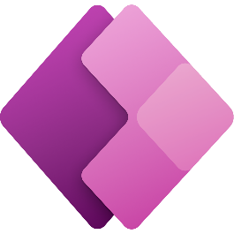
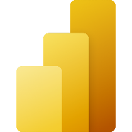
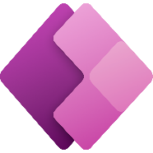



Microsoft Power Platform
A complete low-code solution
Power BI
Business analytics
Power Apps
Application development
Power Automate
Workflow automation
Power Virtual Agents
Intelligent virtual agents
Data connectors
Management
tools
AI Builder
Microsoft Dataverse
Add pre-built or
custom connectors
Predict outcomes with low-code AI.
Unify and standardize your data.
Control access, security and governance.
Notes:
Microsoft Power Platform is a product family that delivers innovative business solutions across one seamlessly integrated platform. While the Power Platform has capabilities which will impress any seasoned developer, it is designed to be approachable and accessible to citizen developers
Power BI, Power Apps, Power Automate and Power Virtual Agents allow any business to analyze & visualize real-time business performance, quickly and easily build custom apps, automate workflows and integrate AI capabilities. Power Platform provides a low code interface for any user to quickly create custom apps while simultaneously providing robust tools for pro developers. This makes it possible to integrate innovative solutions across Azure, Modern Workplace, Dynamics 365 and standalone applications. At the intersection of these products lies digital transformation – giving the customer the power to innovate anywhere, while unlocking value everywhere.
=====

Slide 3
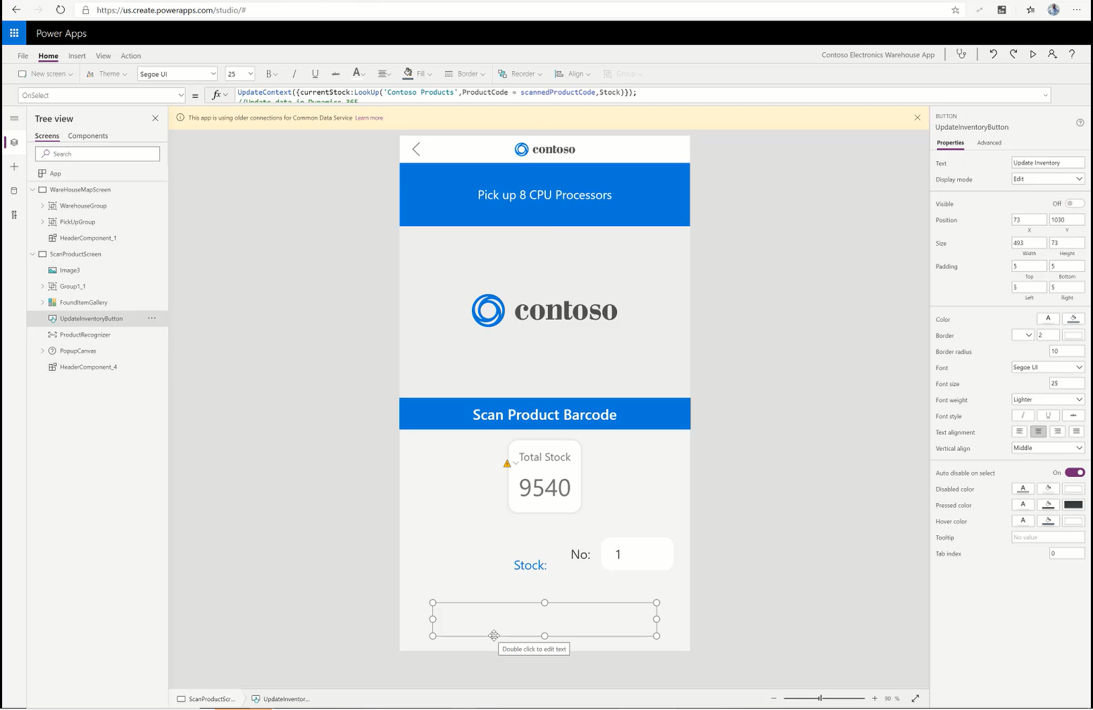
Power Apps Empower everyone to create apps to solve business challenges
Use Power Apps to rapidly create web and mobile front ends using a drag and drop UI.
Build once and deploy apps in one click across iOS, Android, Windows, and Web.
Customize every detail of an app to optimize for specific tasks, roles, and industries.
Enable pro developers to create re-usable components to share with citizen developers
Connect to data using pre-built or custom connectors.
Notes:
Power Apps is the toolset for low-code app development.

Slide 4
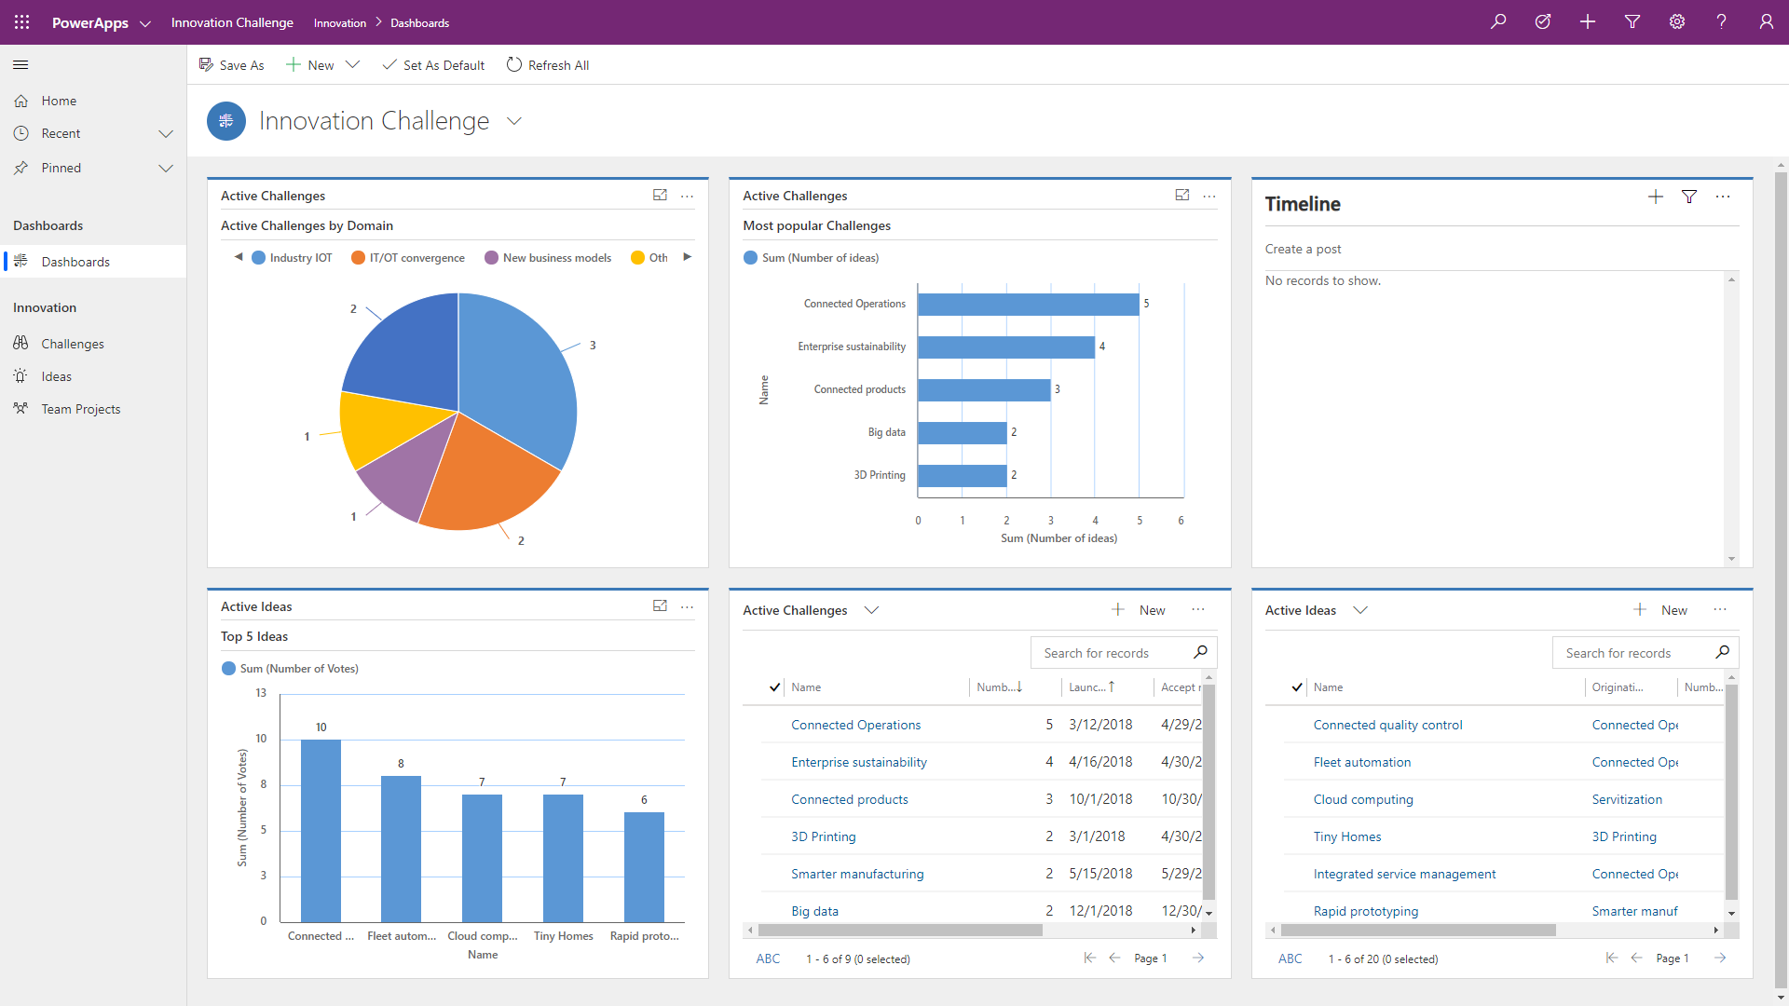
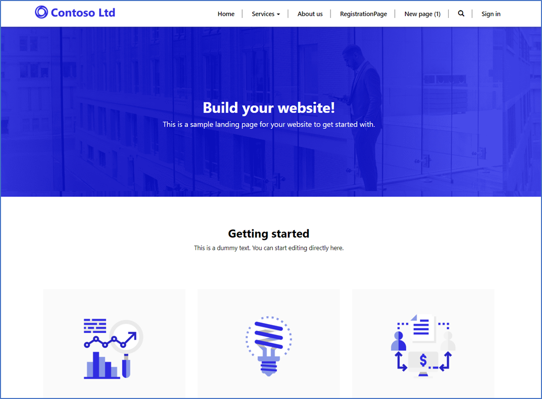
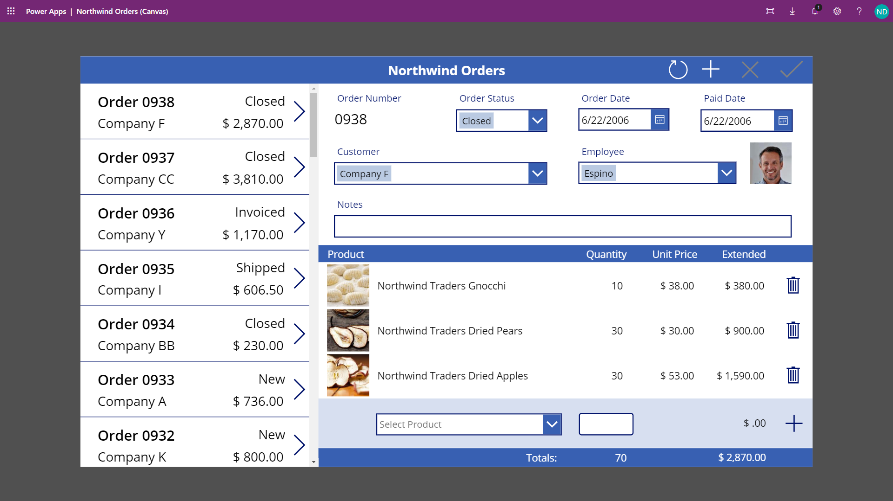
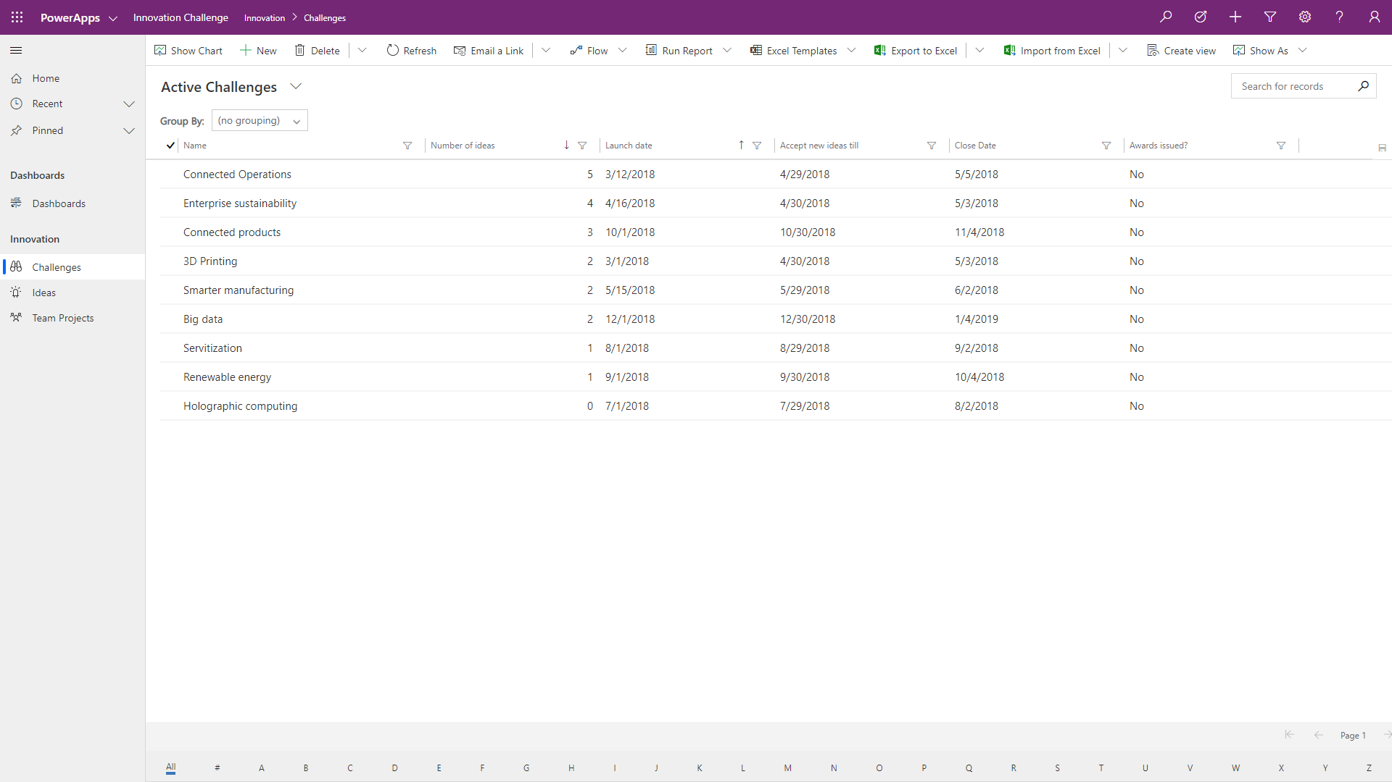
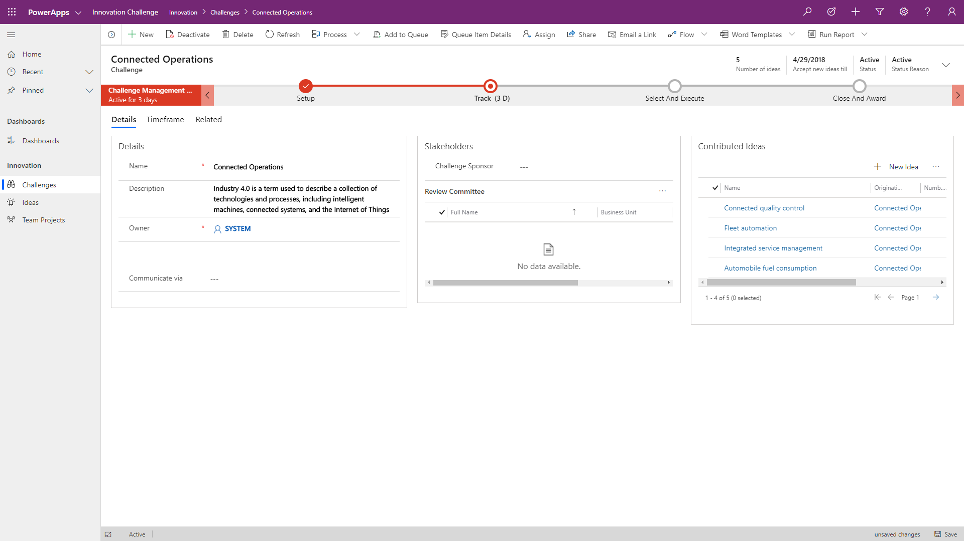
Types of Power Apps
Canvas apps start with user experience, with pixel-perfect control to build highly customized task- and role-based apps that mash up data from 200+ sources
Model-driven apps leverage your data model, relationships, and business processes to automatically generate immersive, responsive applications
Portal apps are web-based apps that allow both internal and external stakeholders to view and update CDS data securely.
Notes:
There are three styles of applications; canvas, model-driven and portals. Power Apps canvas applications can also be embedded into SharePoint, Teams, Power BI and model-driven applications. Portals enable makers to build low-code, responsive websites which allow external users to interact with the data stored in Dataverse.
Model-driven apps require a CDS database and are built on top of the data modeled in that database instance. Model-driven apps materialize views and detail screens based on the data structure. Model-driven apps are mobile friendly and in responsive layout out-of-the box and allow business process flow guidance, which in general leads to them being used for heavy data maintenance or backend operating teams
Canvas apps on the other hand can be built with or without a CDS database. They use connectors to access data and services. Canvas apps can start from a blank screen like an artist’s canvas and the creator manually lays out each screen. This allows the creator to have complete control of placement of controls on the canvas. Therefore, in many use cases they are for pixel-perfect designed applications that for instance are used by field workers from their mobile devices.
Power Apps portals are responsive websites that allow external users to interact with data stored in the CDS of the environment where the portal has been deployed. Allowing customers and partners to work with CDS data either anonymously or using commercial login providers including a variety of industry standard protocols like SAML2, OpenID Connect and WS-Fed. In order to use Power Apps portals a Common Data Service must be provisioned in the environment.

Slide 5
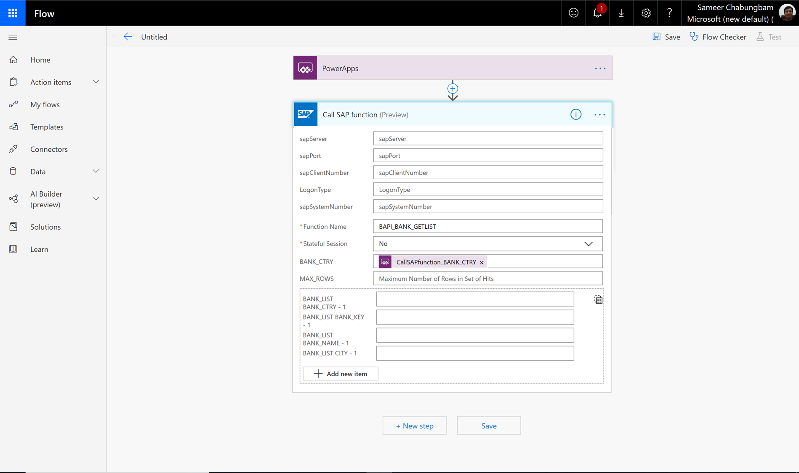
Power Automate Yesim business processes across Power Platform
Expand and improve business processes with integrated RPA workflows.
Send automatic reminders for past due tasks.
Move business data between systems on a schedule.
Create a flow once and enable makers to use it across the Power Platform.
Extend the automation capabilities in Power Automate to on-premises processes and tasks with Power Automate Desktop.
Notes:
Power Automate is an online workflow service that allows automating tasks across multiple services using connectors or UI automation.
Power Automate flows are started when a triggering event occurs, there are three types of triggers
▪ Automated (When an event occurs)
▪ Scheduled (Recurrence)
▪ Instant (Button click)
Once triggered, the flow proceeds to execute the actions defined in the flow. Conditions are used to guide the flow to the proper actions.
Business process flows (BPF) can be used to guide a user through an interactive process.
Power Automate Desktop – repetitive tasks

Slide 6
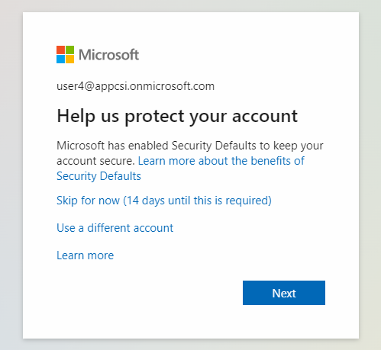

Slide 7
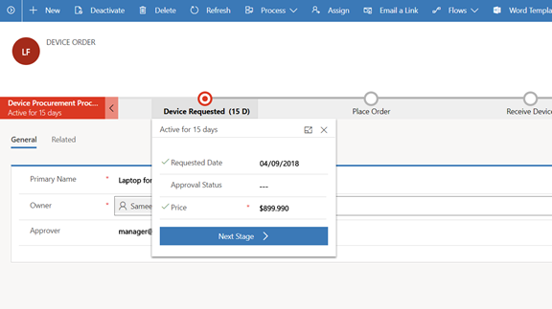
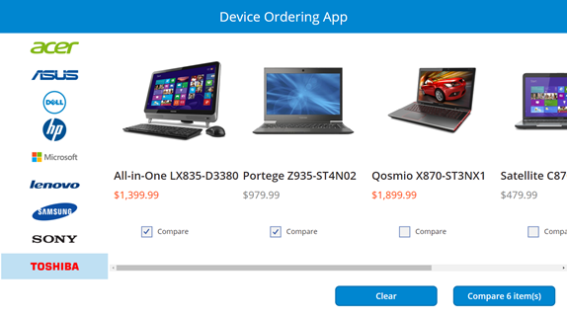
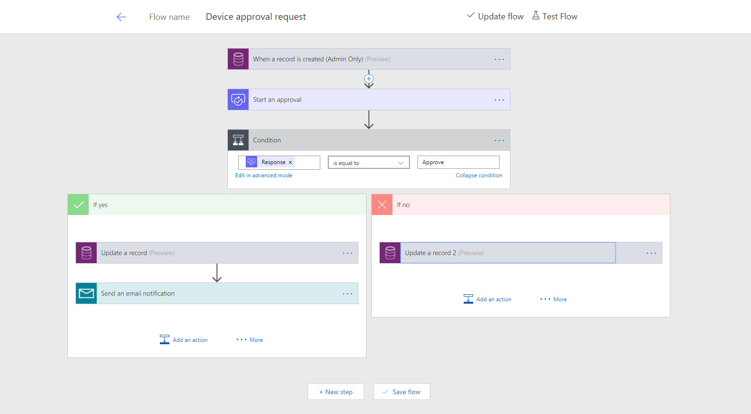
Business scenario
Imagine an organization where every three years employees go through a hardware refresh cycle
We will streamline the device order, procurement and approval process and view aggregate reports
The employee-facing device ordering app needs to run in a web browser and on mobile devices

Slide 8
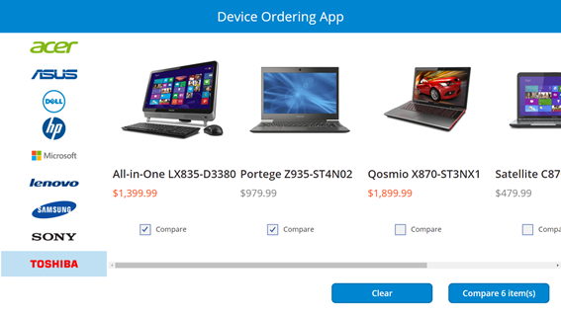
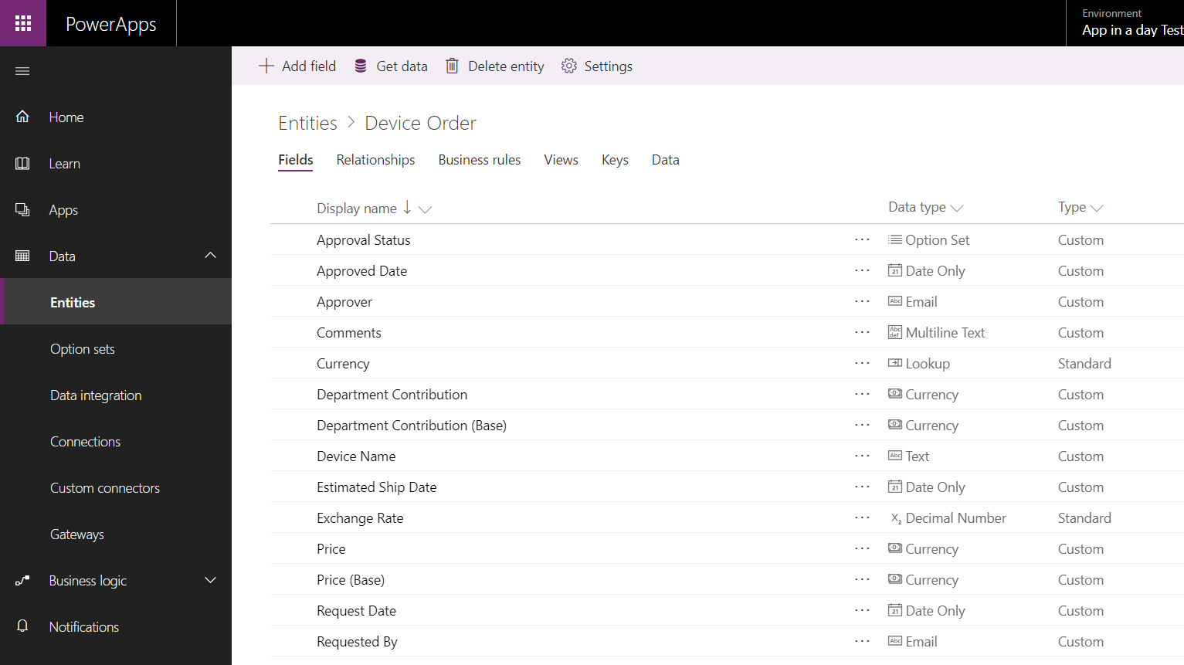
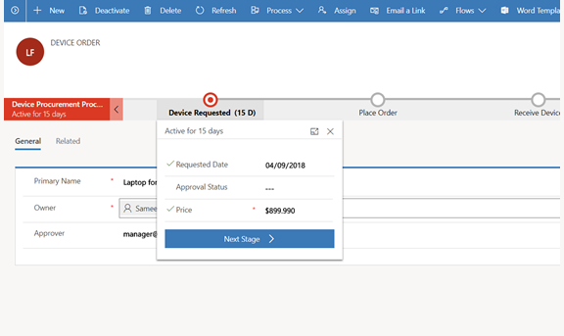
Lab objectives
Build a Power Apps Canvas App for employee facing device ordering experience
Use Dataverse to store the device orders in the cloud
Build a Power Apps Model-driven app to complete the procurement process
Use Power Automate to build an approval workflow for device approval

Slide 9

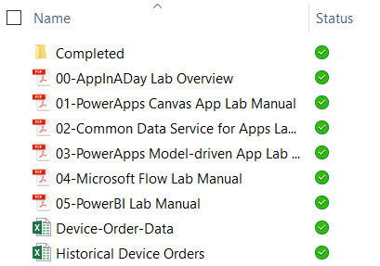
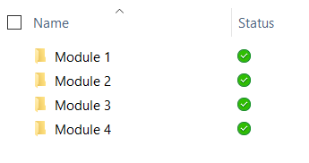
Lab content
Package: https://bit.ly/3lBFEkA
Unzip the package on your local machine
Follow instructions: “01 - Create A Machine Ordering Power Apps Canvas App”
Lab docs:
Contains 4 modules with a lab doc for each:
01 - Create a machine ordering Power Apps canvas app
02 - Create a Dataverse table for the machine ordering app
03 - Create a model-driven Power Apps app for machine ordering
04 - Integrate a Power Apps app with Power Automate
Completed modules:

Slide 10
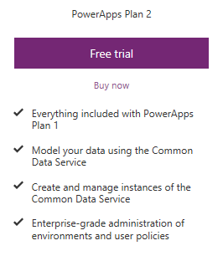
Pre-requisites
Valid Power Apps license:
Dataverse usage requires a Power Apps license
Visit https://powerapps.microsoft.com/pricing/ and click Free Trial
If you are unable to acquire a trial license: Ask the instructor for a trial user account that you may use for this session OR Create your own Office 365 trial tenant – http://aka.ms/Office365E5Trial
Power Apps authoring environment:
Launch https://make.powerapps.com using any modern browser
Power Apps mobile apps (Optional):
PowerApps – iOS : https://aka.ms/PowerAppsiOS PowerApps – Android : https://aka.ms/PowerAppsAndroid

Slide 11
Provision environment and Dataverse
This lab requires a new Power Apps environment and database that was provisioned for this class
Go to the Power Apps Admin center – http://aka.ms/ppac
Select +New environment, fill out the form using a Trial Environment, and select Create Environment
Select the Create database option
Fill out the form, check the box to include sample apps and data and select Create my database
Your new environment will be added to the list of environments
IMPORTANT: The database has not yet been provisioned
Select the environment you just created
Wait for the “Provisioning database…” message to go away
You may need to refresh the screen every couple of minutes
Once the provisioning is complete, then proceed to create apps in the environment
Notes:
Please review instruction manual 00 for details.

Slide 12
Lab overview
Canvas App
Dataverse
Model-driven
App
Power Automate
Notes:
This slide is intended to set the stage for all of the lab content and morphs into the following slide in show mode
The first lab is centered around Accessing & Preparing the data
Then we’ll cover Data modeling and explortation
After lunch, we’ll look at the different ways we can visualize the data using PowerBI on different platforms
Lastly, in labs 4 and 5 we’ll review publishing, accessing, and building & sharing dashboards

Slide 13
Hands-on-lab 1
Module 1: Power Apps Canvas App

Slide 14
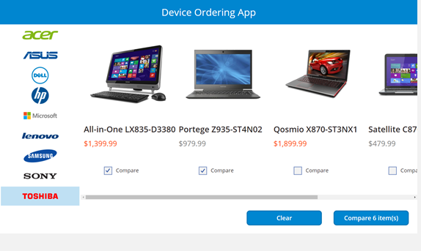
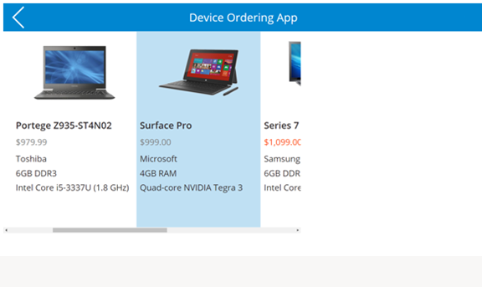
Module 1:Learning objectives
Canvas App
Dataverse
Model- driven
App
Power Automate
Sign-in and create a new Canvas App
Connect to data sources
Filter data
Work with multiple screens and navigation
Customize the user experience – galleries and controls

Slide 15
Hands-on-lab 2
Module 2: Dataverse

Slide 16
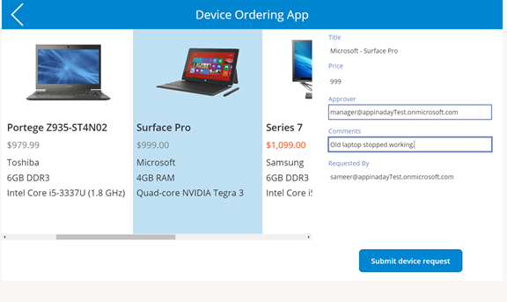
Module 2: Learning objectives
Canvas App
Dataverse
Model- driven
App
Power Automate
Provision a database, if you haven’t already done this
Work with entities
Get familiar with standard tables
Create a custom tables
Customize table columns and choices
Create calculated fields
Work with canvas app
Use the canvas app form control to save data
Use the Office 365 connector to get user’s manager info
Configure canvas app settings
Save and share a canvas app
Run a canvas app on a mobile device

Slide 17
Hands-on-lab 3
Module 3: Power Apps Model-driven App

Slide 18
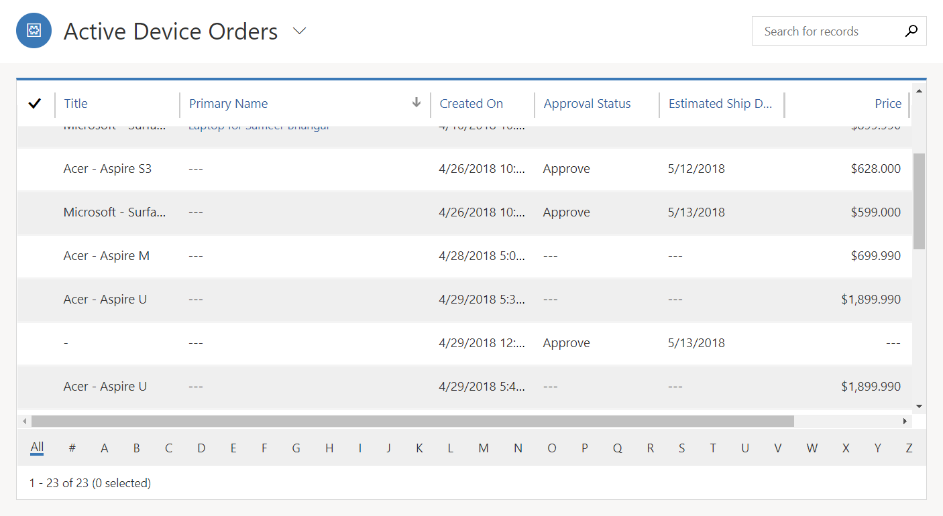
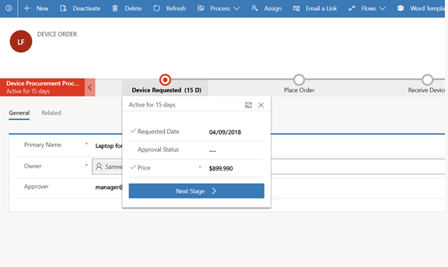
Module 3: Learning objectives
Canvas App
Dataverse
Model- driven
App
Power Automate
Create a standalone Model-driven app
Customize forms for the Model-driven app
Create a Business Process Flow

Slide 19
Hands-on-lab 4
Module 4: Power Automate

Slide 20
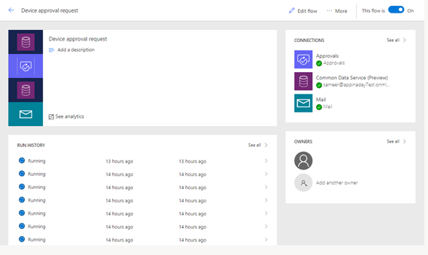
Module 4: Learning objectives
Canvas App
Dataverse
Model- driven
App
Power Automate
Trigger a flow when a new record is created
Send an approval request
Conditional branching based on the approval response
Send email notifications
Update the record with the approval status and the approver’s comments
Use the approval center on web and mobile
Check the status of flow runs

Slide 21
Next steps - Build Your Own Power Apps Solutions
Power BI
Power Virtual Agent
Microsoft Teams
4
Power Apps Portal App
These labs continue to build the app functionality from the prior labs

Slide 22
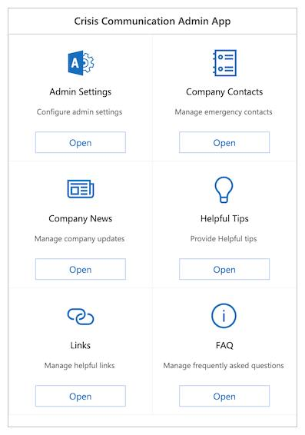
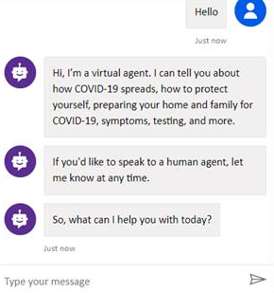
Crisis response labs
Crisis Communication App
Crisis Bot
These labs are independent of the AIAD labs. They can be completed in the AIAD environment, or another non-production instance

Slide 23
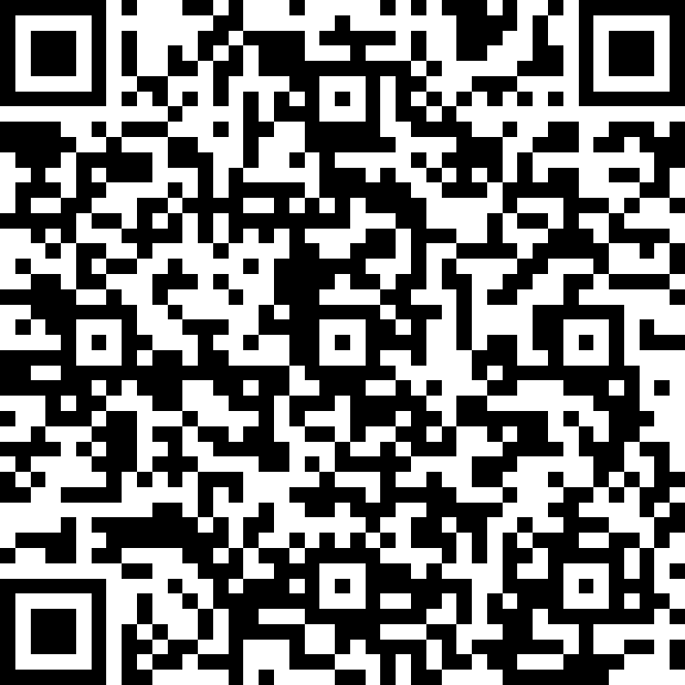

Feedback Form
https://forms.office.com/r/pvw9TuagbL
Notes:
https://forms.office.com/r/pvw9TuagbL

Slide 24
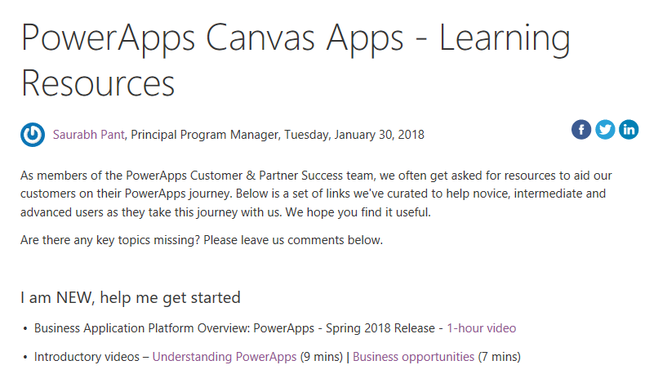
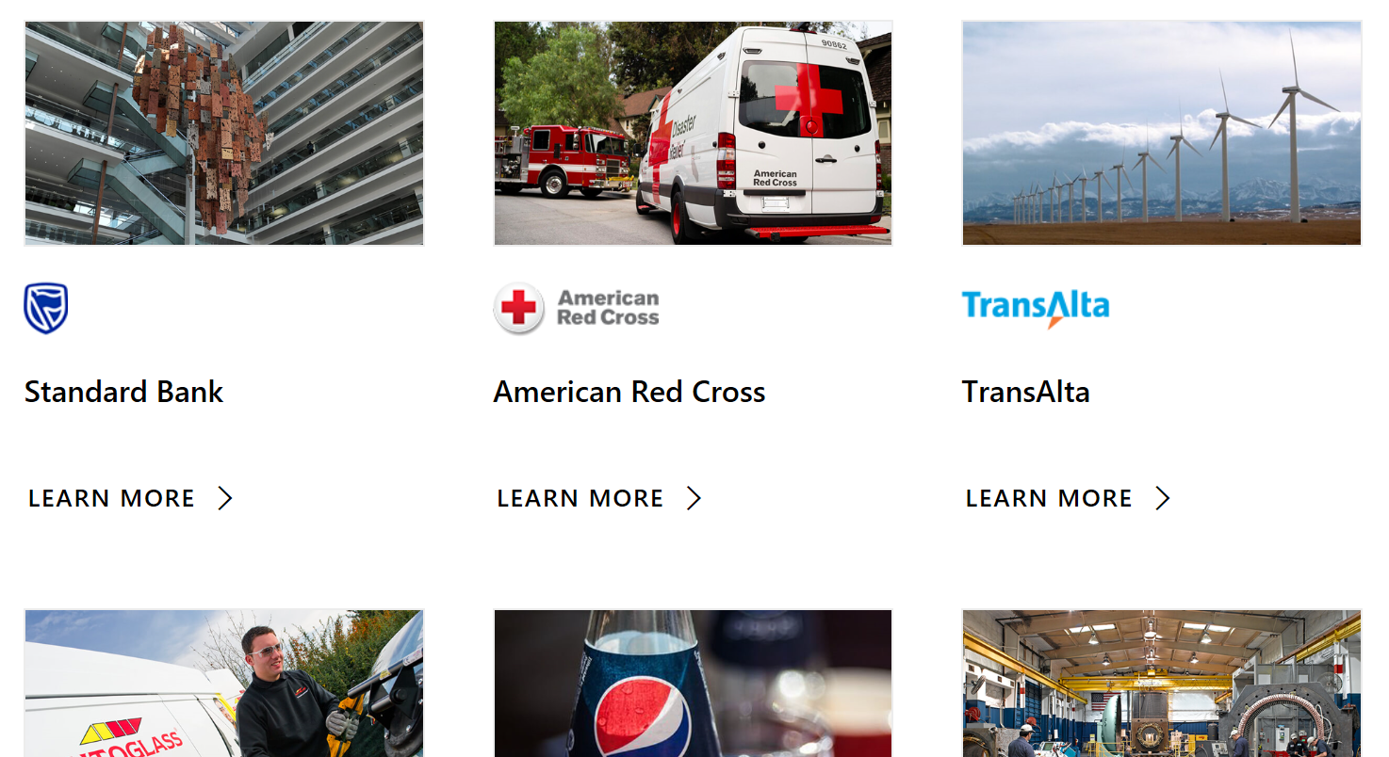
Learning resources and Customer stories
Learning resources
http://aka.ms/powerapps-resources
http://aka.ms/flow-resources
Customer stories
http://aka.ms/PowerAppsStories
http://aka.ms/GJPepsiVideo
http://aka.ms/ArrivaVideo
http://aka.ms/HeathrowVideo

Slide 25
Closing Slide

